Slide 1
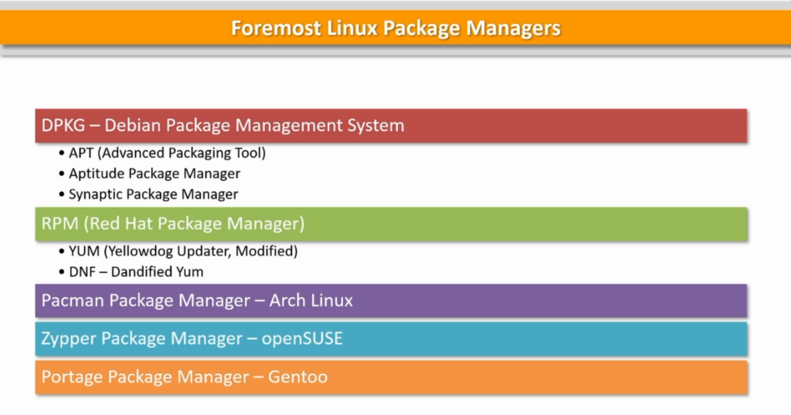

Slide 2
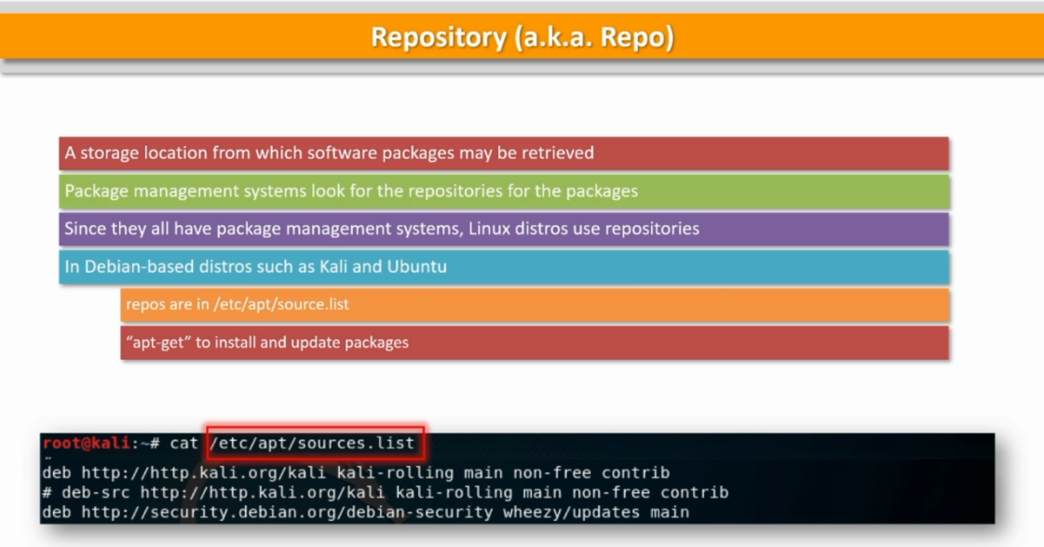

Slide 3
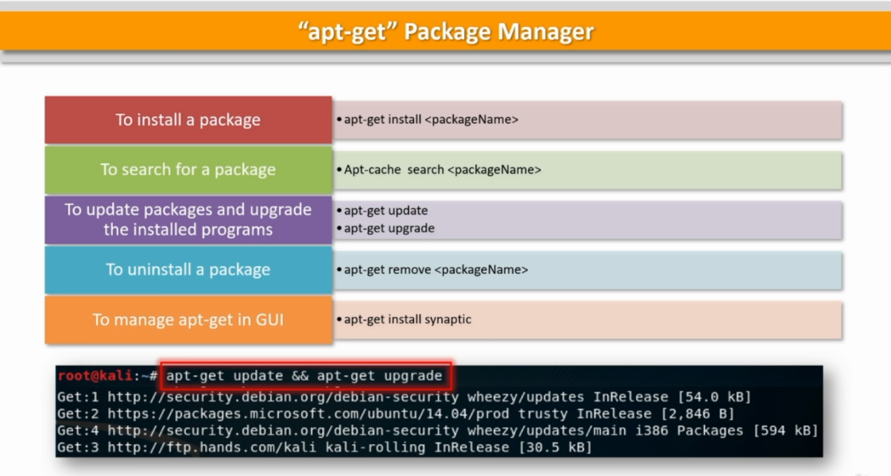

Slide 4
$ apt search pidcat
$ sudo apt-get install pidcat
$ man pidcat
$ sudo apt-get remove pidcat
$ man pidcat
$ sudo apt-get install synaptic
RUN on GUI
$ synaptic
$ sudo synaptic
$ leafpad

Slide 5
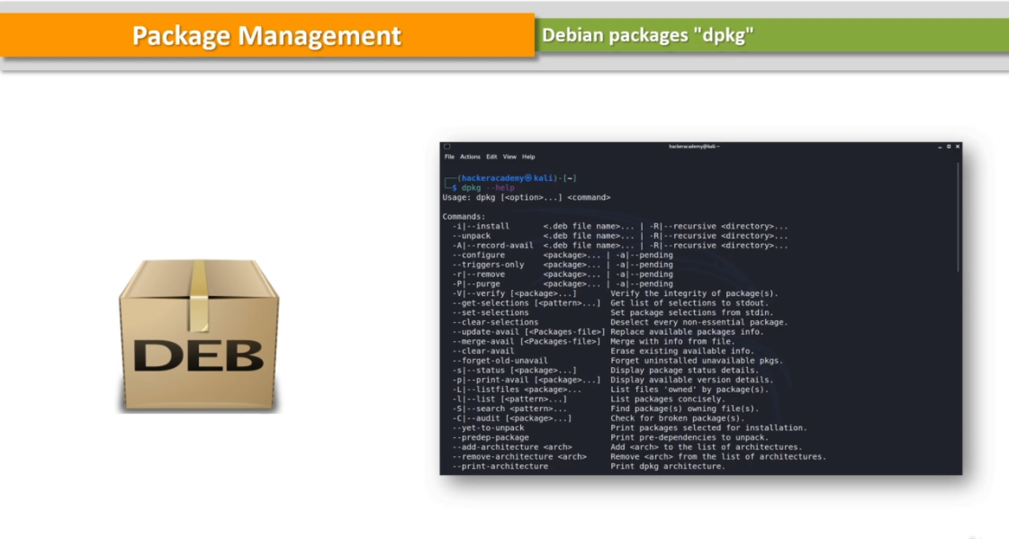

Slide 6
$ dpkg –help
$ cd ~/Downloads
$ ls
skypeforLinux-64.deb
$ sudo dpkg -I skypeforLinux-64.deb

Slide 7
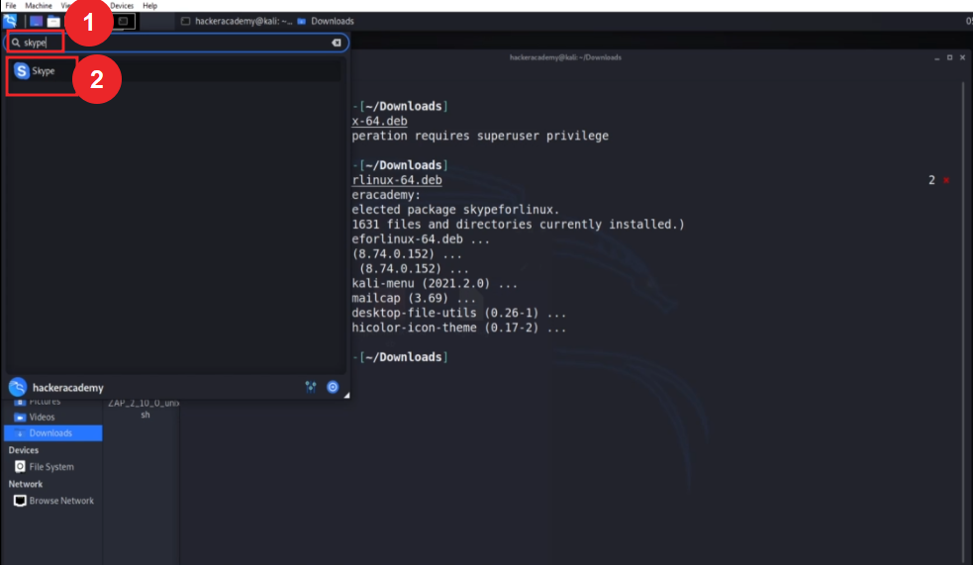

Slide 8
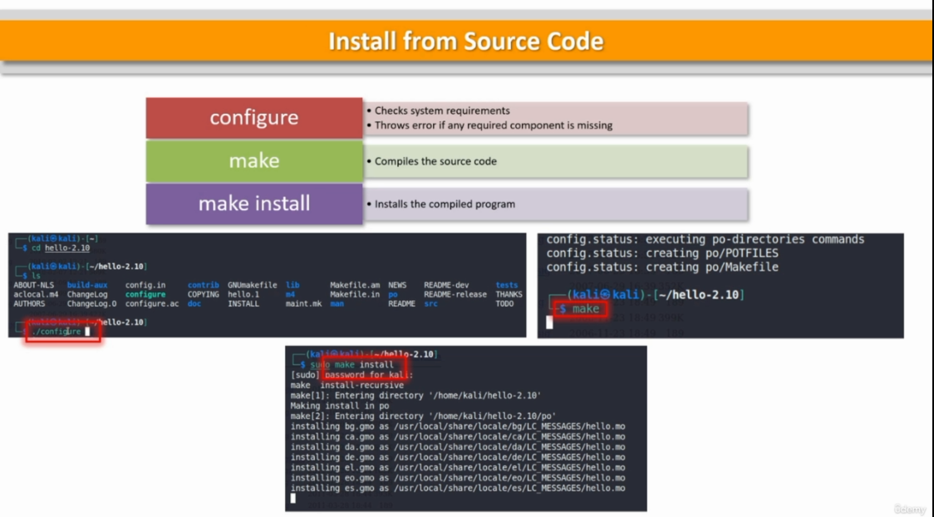

Slide 9
http://www.gnu.org
-> SOFTWARE -> hello -> Download -> hello-2.10.tar.gz
$ wget https://ftp.gnu.org/gnu/hello/hello-2.10.10.tar.gz
$ tar –xvf hello-2.10.10.tar.gz
$ cd ~/hello-2.10
$ ls
configure
$ ./configure
$ make
$ sudo make install
$ hello
Hello, world!

Slide 10


Slide 11
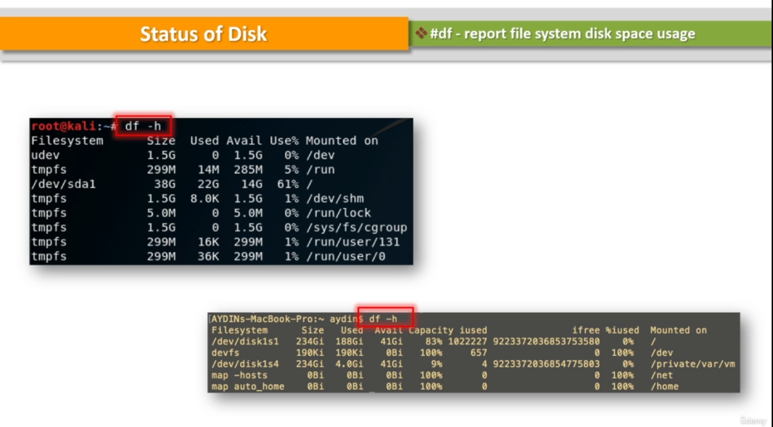

Slide 12
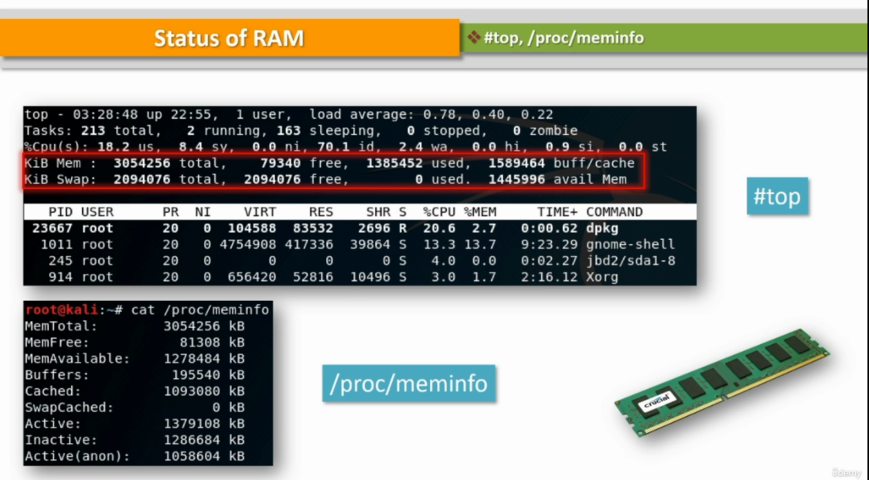

Slide 13
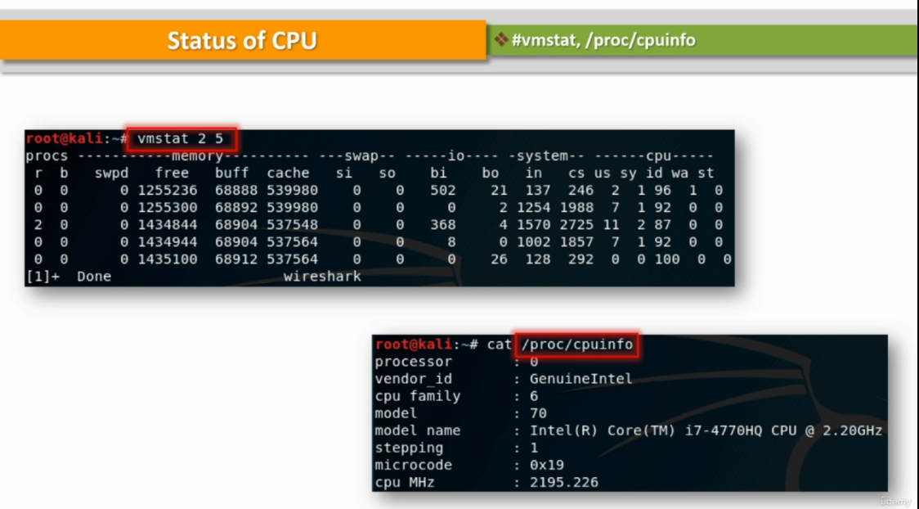

Slide 14
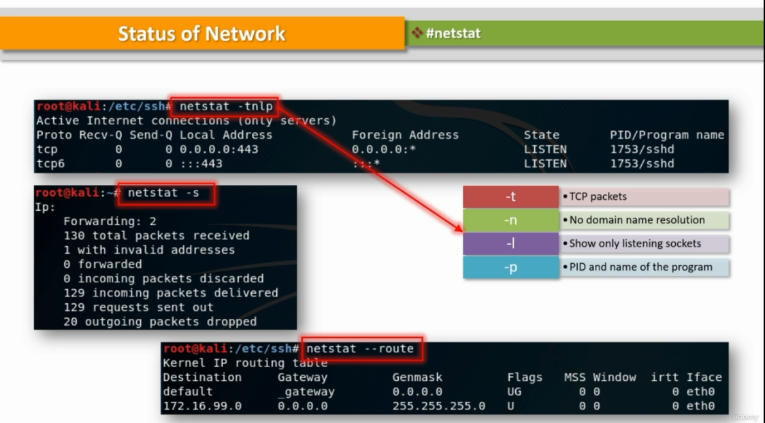

Slide 15
$ df –h
$ top
$ cat /proc/meminfo
$ vmstat 2 5
$ cat /proc/cpuinfo
$ netstat -tnlp
$ netstat -s
$ netstat –route

Slide 16
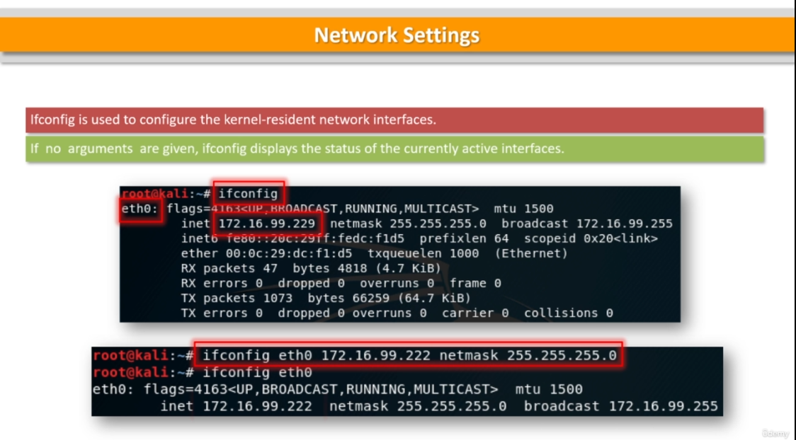

Slide 17
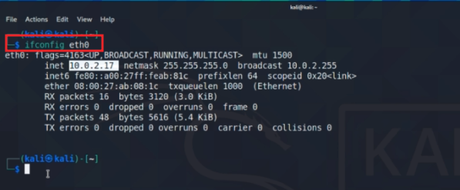

Slide 18
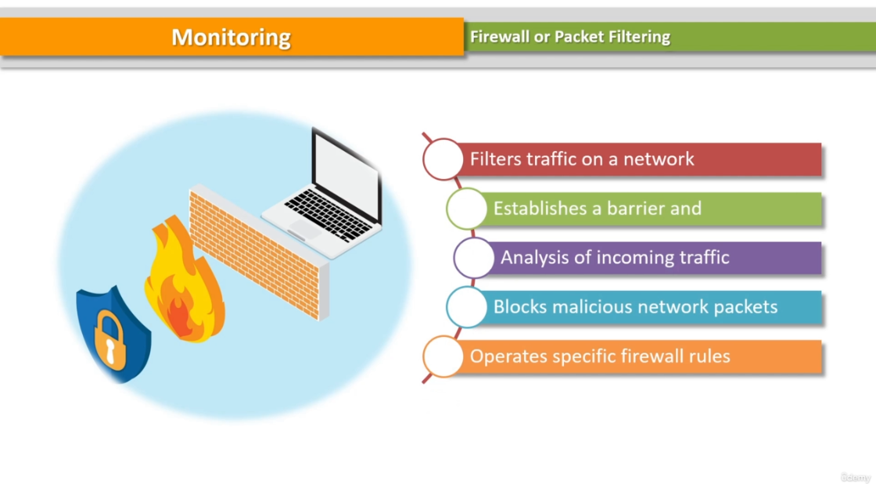

Slide 19
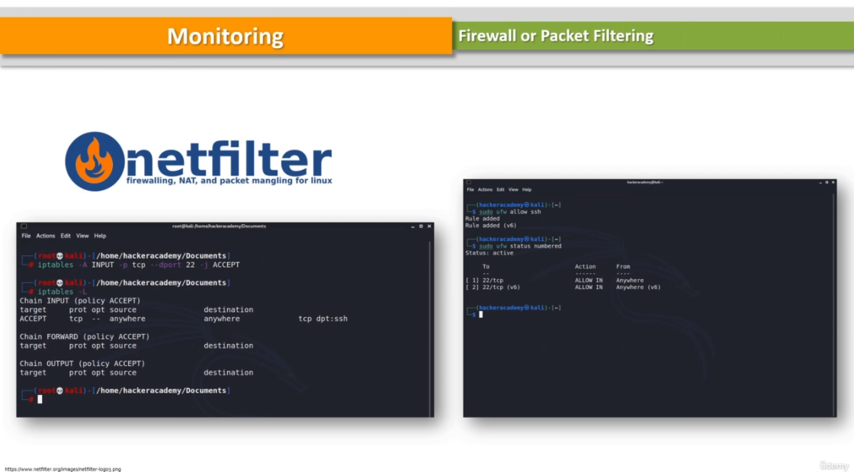

Slide 20
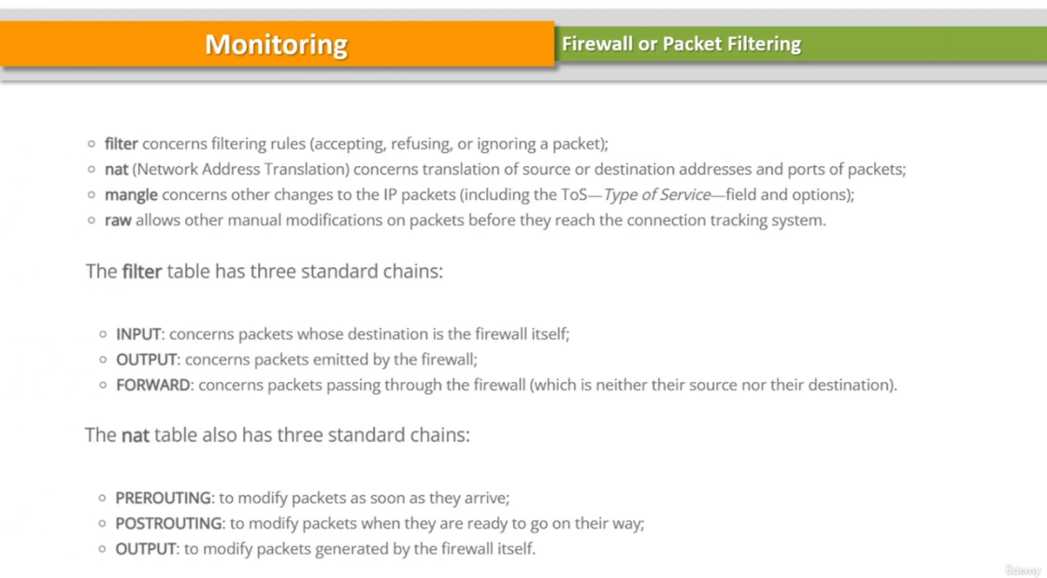

Slide 21
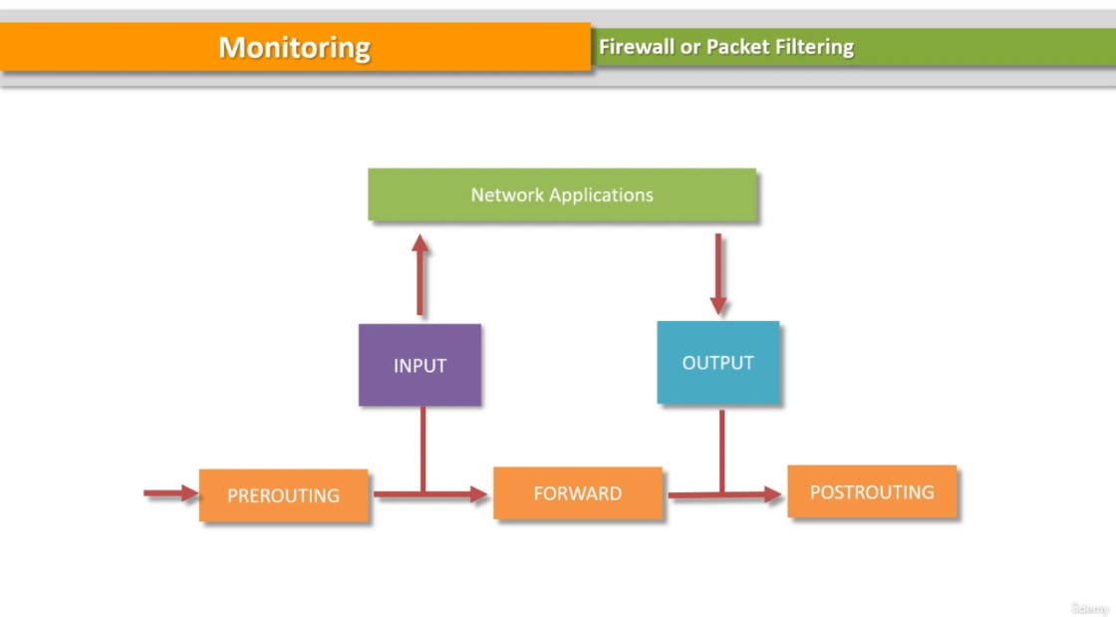

Slide 22
$ sudo su –
$ iptables –h
$ iptables –L
$ iptables -A INPUT -p tcp -- dport 22 -j ACCEPT
$ iptables -L --line-numbers
$ iptables –D INPUT 1
$ iptables –L
$ ufw –help
$ sudo ufw allow ssh
$ sudo ufw enable
$ sudo ufw status numbered

Slide 23
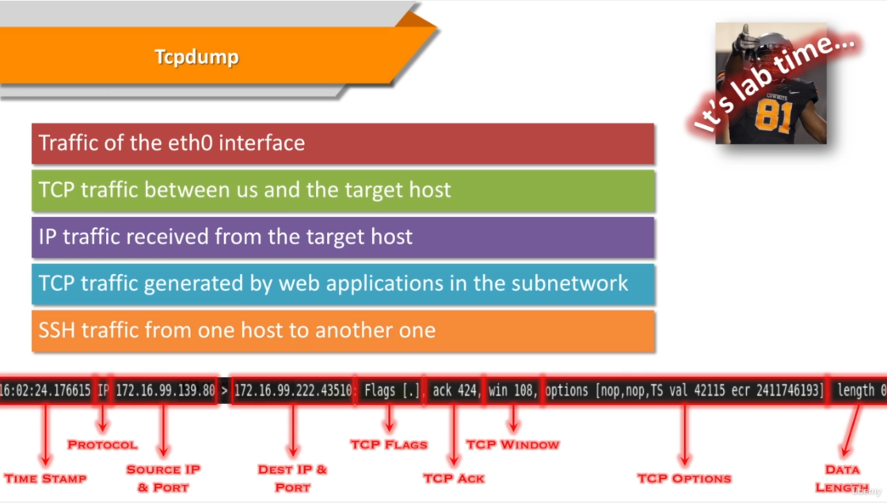

Slide 24
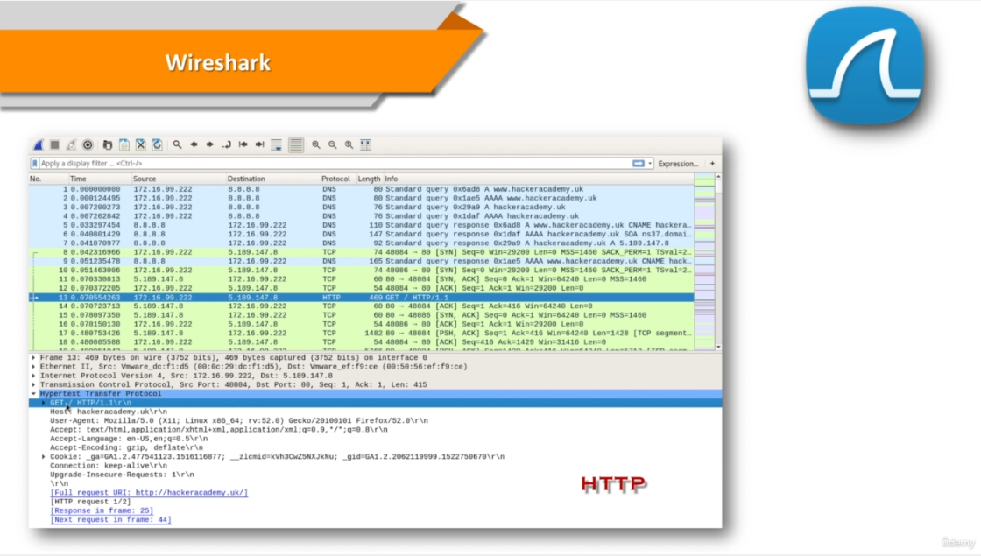

Slide 25
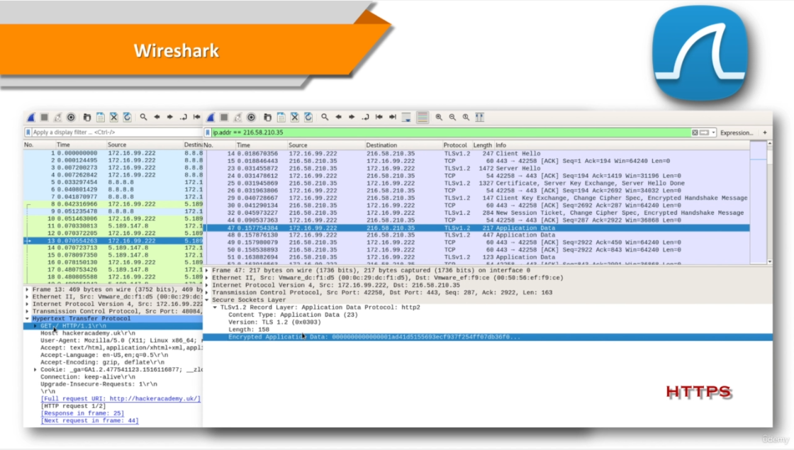

Slide 26
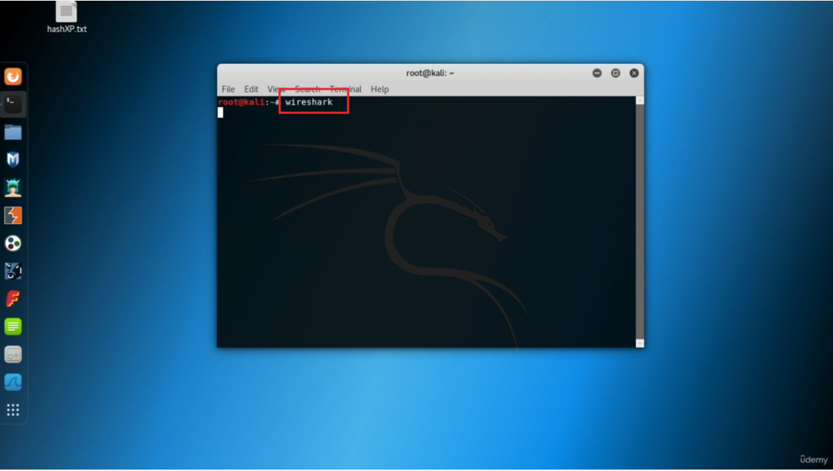

Slide 27
$ wireshark
Browser
http://www.hackeracademy.uk/

